Slide 1
House Renting Market in GTA
CSDA1050 Capstone Project
Presented by Hui Fang Cai
Date : May 24, 2019

Slide 2
Objective
Goal: is to study the rental prices on GTA properties listed on trebhome.com, thus to find out which one is the best for investment.
Application: The result of this study might be used by investors for their housing investments.
As an investor, answer questions like
1. What is the best rental price for the property? If too low, no profit gain; if too high, the property may not be rented.
2. What is the best property that I need to buy for investment based on the predicted rental price ?

Slide 3
Data Collection
Data Source : trebhome.com
https://listings.trebhome.com/listings?%24loc=Toronto&%24zoom=0&%24latitude=35.422943522054865&%24longitude=0&%24orderby=price&saleOrRent=RENT&latitude=%3E%3D-89.91227567527925&latitude=%3C%3D89.9766532819623&longitude=%3E%3D-180&longitude=%3C%3D180&%24gid=treb&class=FREE&class=CONDO&availability=A&_min_price=%24300&price=%3E%3D300&price=%3C%3D50000&area=Toronto&%24take=3164
Web scraping: BeautifulSoup + Requests with Python
Result data:
3164 records and 6 variables with duplicates.
The variable names are ID, Address, Bedrooms, Bathrooms, Type, Price.

Slide 4
Data Cleansing
1) Load data
2) Explore data
3) Clean data, remove duplicates
4) Remove missing values
5) Change datatype as necessary

Slide 5
Statistics
Statistics about Price, Bedrooms , Bathrooms .
Price:
Min. 1st Qu. Median Mean 3rd Qu. Max.
650 2100 2475 3022 3200 22500
Bedrooms:
Min. 1st Qu. Median Mean 3rd Qu. Max.
1.000 1.000 2.000 2.104 3.000 8.000
Bathrooms:
Min. 1st Qu. Median Mean 3rd Qu. Max.
1.000 1.000 1.000 1.634 2.000 8.000

Slide 6
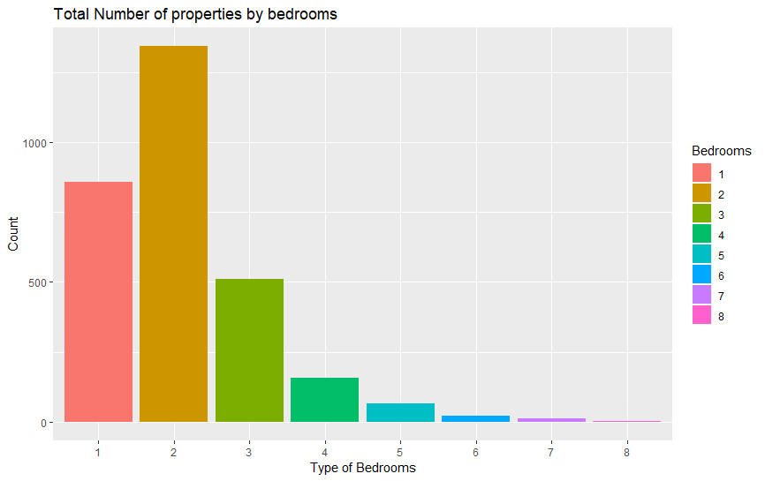
Frequency & Visualization

Slide 7
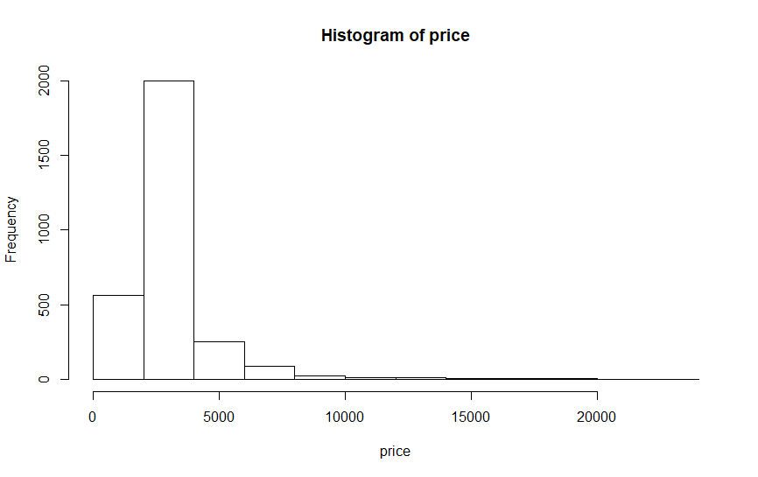
Price Distribution
Right skewed !

Slide 8
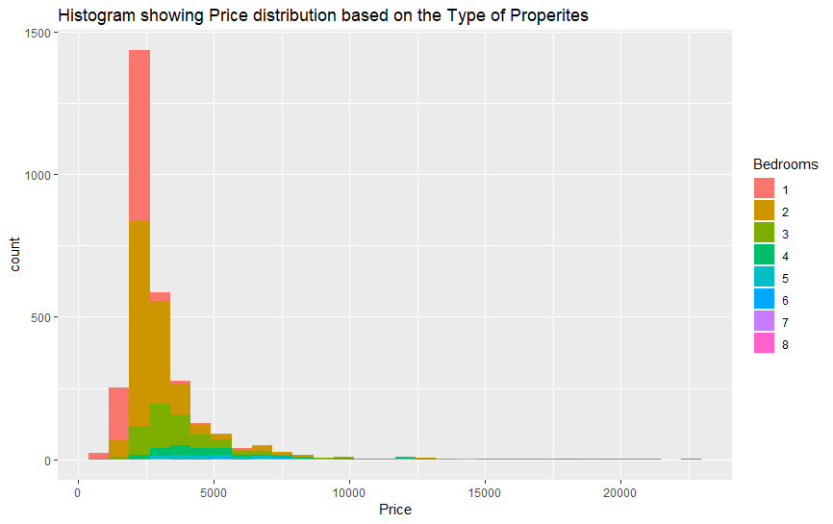
Price distribution by Bedroom Type

Slide 9
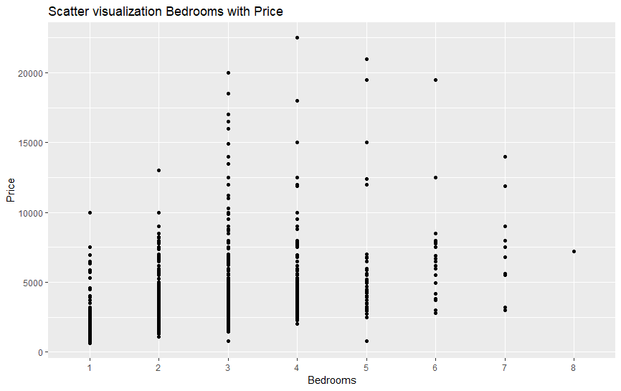
Scatter Visualization bedrooms with Price

Slide 10
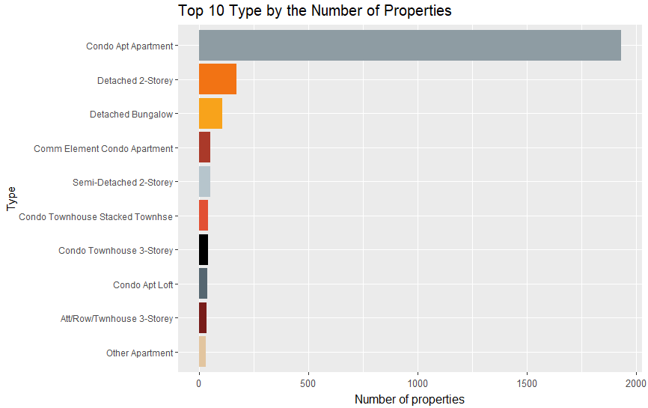
Top 10 Type by # of Properties

Slide 11
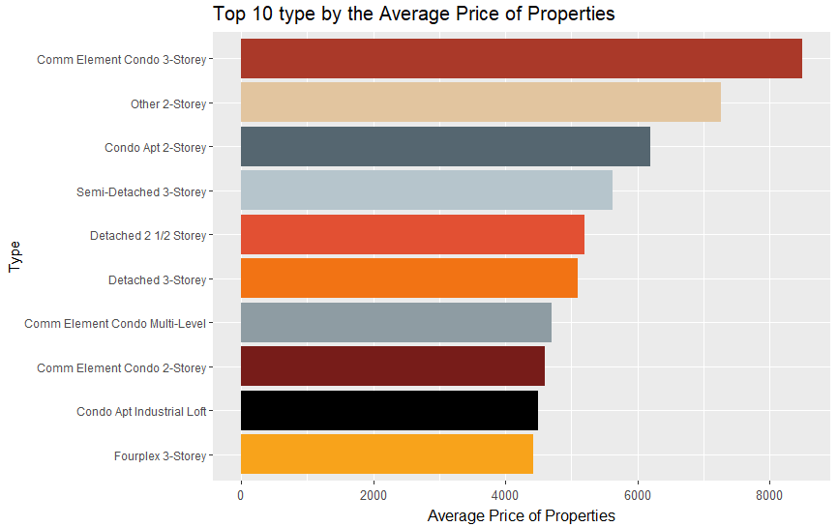
Top 10 Type by Avg Price

Slide 12
Summary Table
Bedrooms | Bathrooms | mean_price1
1 | 1 | 1973.371
1 | 2 | 3017.593
1 | 3 | 1175
2 | 1 | 2316.606
2 | 2 | 2996.603
2 | 3 | 4857.658
3 | 1 | 2675.581
3 | 2 | 3428.328
3 | 3 | 5213.755
3 | 4 | 7559.5
3 | 5 | 10500
3 | 6 | 3900
4 | 1 | 3426.667
4 | 2 | 3599.611
4 | 3 | 5099.99
4 | 4 | 7288.704
4 | 5 | 11025
4 | 6 | 8800
4 | 7 | 11900
5 | 2 | 4507.25
5 | 3 | 4257.689
5 | 4 | 4801.984
5 | 5 | 9018.571
5 | 6 | 12825
5 | 7 | 13700
6 | 2 | 3000
6 | 3 | 4775
6 | 4 | 6366.667
6 | 5 | 8040
6 | 6 | 13100
6 | 7 | 7266.667
7 | 3 | 3000
7 | 4 | 9750
7 | 5 | 8731.5
7 | 6 | 7366.667
7 | 8 | 6800
8 | 7 | 7200
Avg Price by Bedrooms (High Level)
Bedrooms | mean_price2
1 | 2080.24
2 | 2816.92
3 | 4209.52
4 | 5707.04
5 | 6445.36
6 | 7533.64
7 | 7732.81
8 | 7200.00

Slide 13
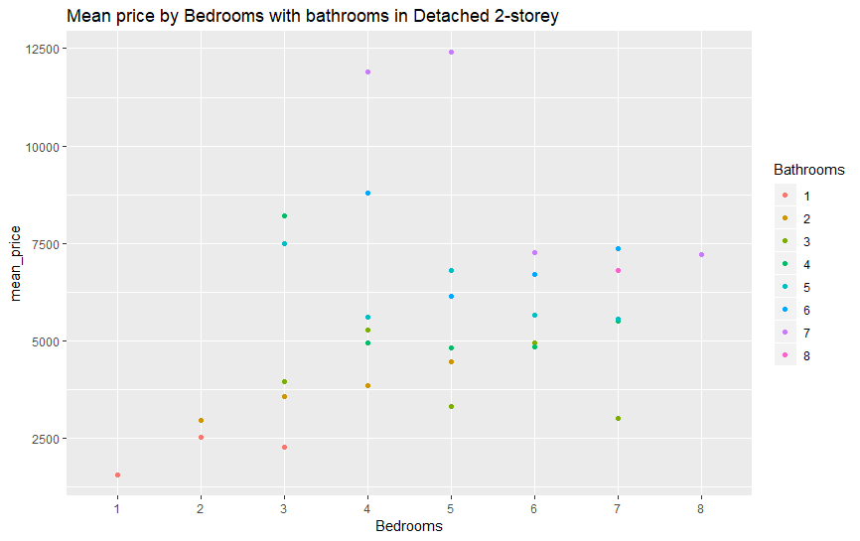
Visualize Avg Price by Bedrooms and bathrooms in Detached 2-storey

Slide 14
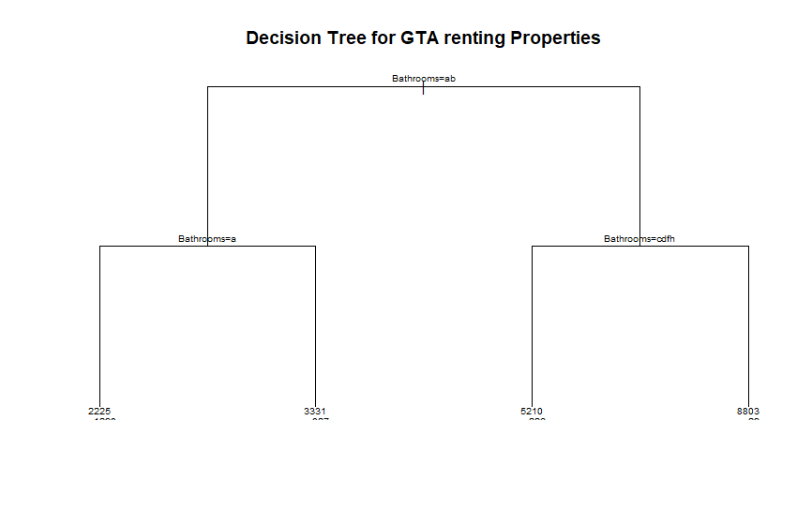
Modelling
Decision Tree Vs. Random Forest (ntree=500)

Slide 15
Decision Tree vs Random Forest
#Comparing the Errors (MAE)of decision tree and random forest with ntree=500)
print(rmse_decision_tree)
[1] 1910.903
print(rmse_random_forest)
[1] 1838.928
print(mae_decision_tree)
[1] 882.7005
print(mae_random_forest)
[1] 838.6105
# It can be concluded random forest performs better than a single decision tree.

Slide 16
Regression Model
Model 1: Look at normal Price with Bedrooms and Bathrooms
Coefficients:
Estimate Std. Error t value Pr(>|t|)
(Intercept) 830.75 64.97 12.787 <2e-16 ***
Bedrooms 119.35 40.31 2.961 0.0031 **
Bathrooms 1186.27 47.39 25.033 <2e-16 ***
Residual standard error: 1355 on 2369 degrees of freedom
Multiple R-squared: 0.4118, Adjusted R-squared: 0.4113
F-statistic: 829.4 on 2 and 2369 DF, p-value: < 2.2e-16
Model 2: Look at log(Price) with Bedrooms and Bathrooms
# To overcome heteroskedasiticity with building log(Price).
Coefficients:
Estimate Std. Error t value Pr(>|t|)
(Intercept) 7.34605 0.01389 528.679 <2e-16 ***
Bedrooms 0.07407 0.00862 8.593 <2e-16 ***
Bathrooms 0.25249 0.01013 24.912 <2e-16 ***
Residual standard error: 0.2897 on 2369 degrees of freedom
Multiple R-squared: 0.4874, Adjusted R-squared: 0.487
F-statistic: 1126 on 2 and 2369 DF, p-value: < 2.2e-16

Slide 17
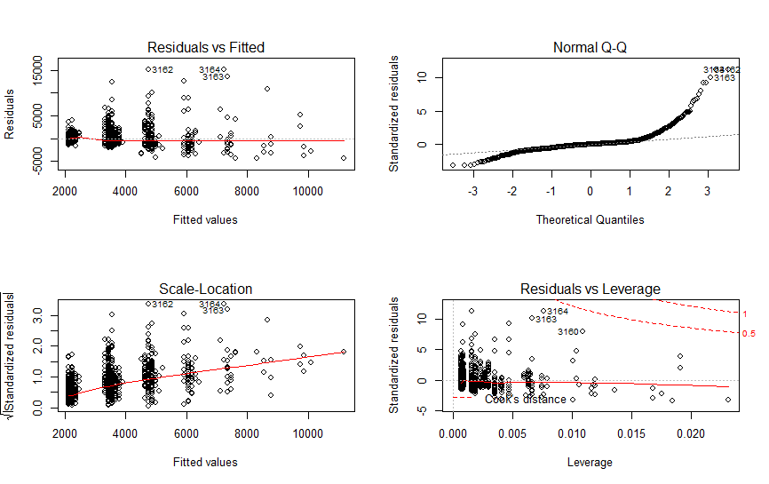
Residuals Plot for Model1

Slide 18
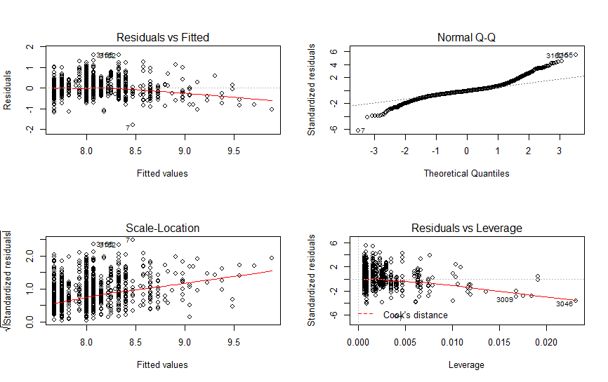
Residuals Plot for Model 2

Slide 19
Regression Model
# It shows linear_model2 is better than linear_model1. Linear_model 2 has Adjusted R-squared: 0.487, p-value: < 2.2e-16. ( but still not good enough, further study needed)
#The relationship shows price with bedrooms and bathrooms is
log(Price)=0.07407*number of Bedrooms +0.25247* number of Bathrooms +7.34605.
This shows that the number of Bedrooms has stronger positive relationships
with the renting Price than the number of bathrooms.
# Evaluate the model
rmse(actual=regression_test$Price,predicted=test_predictions)
[1] 2312.589

Slide 20
Discussion
# Aim of this analysis is to answer a question of "Which ones are the best for investments?"
# Finding "BEST" is hard and it is subjective matter.
# Therefore, rather than concluding which ones are the best for investments, it is much wiser to perform further research about the Toronto area. Since in this analysis we are missing some potentially important variables related to properties. It is possible that the properties have higher rental prices because of low crime rate, convenient transportation, and higher standard interior decorations of property etc.

Slide 21
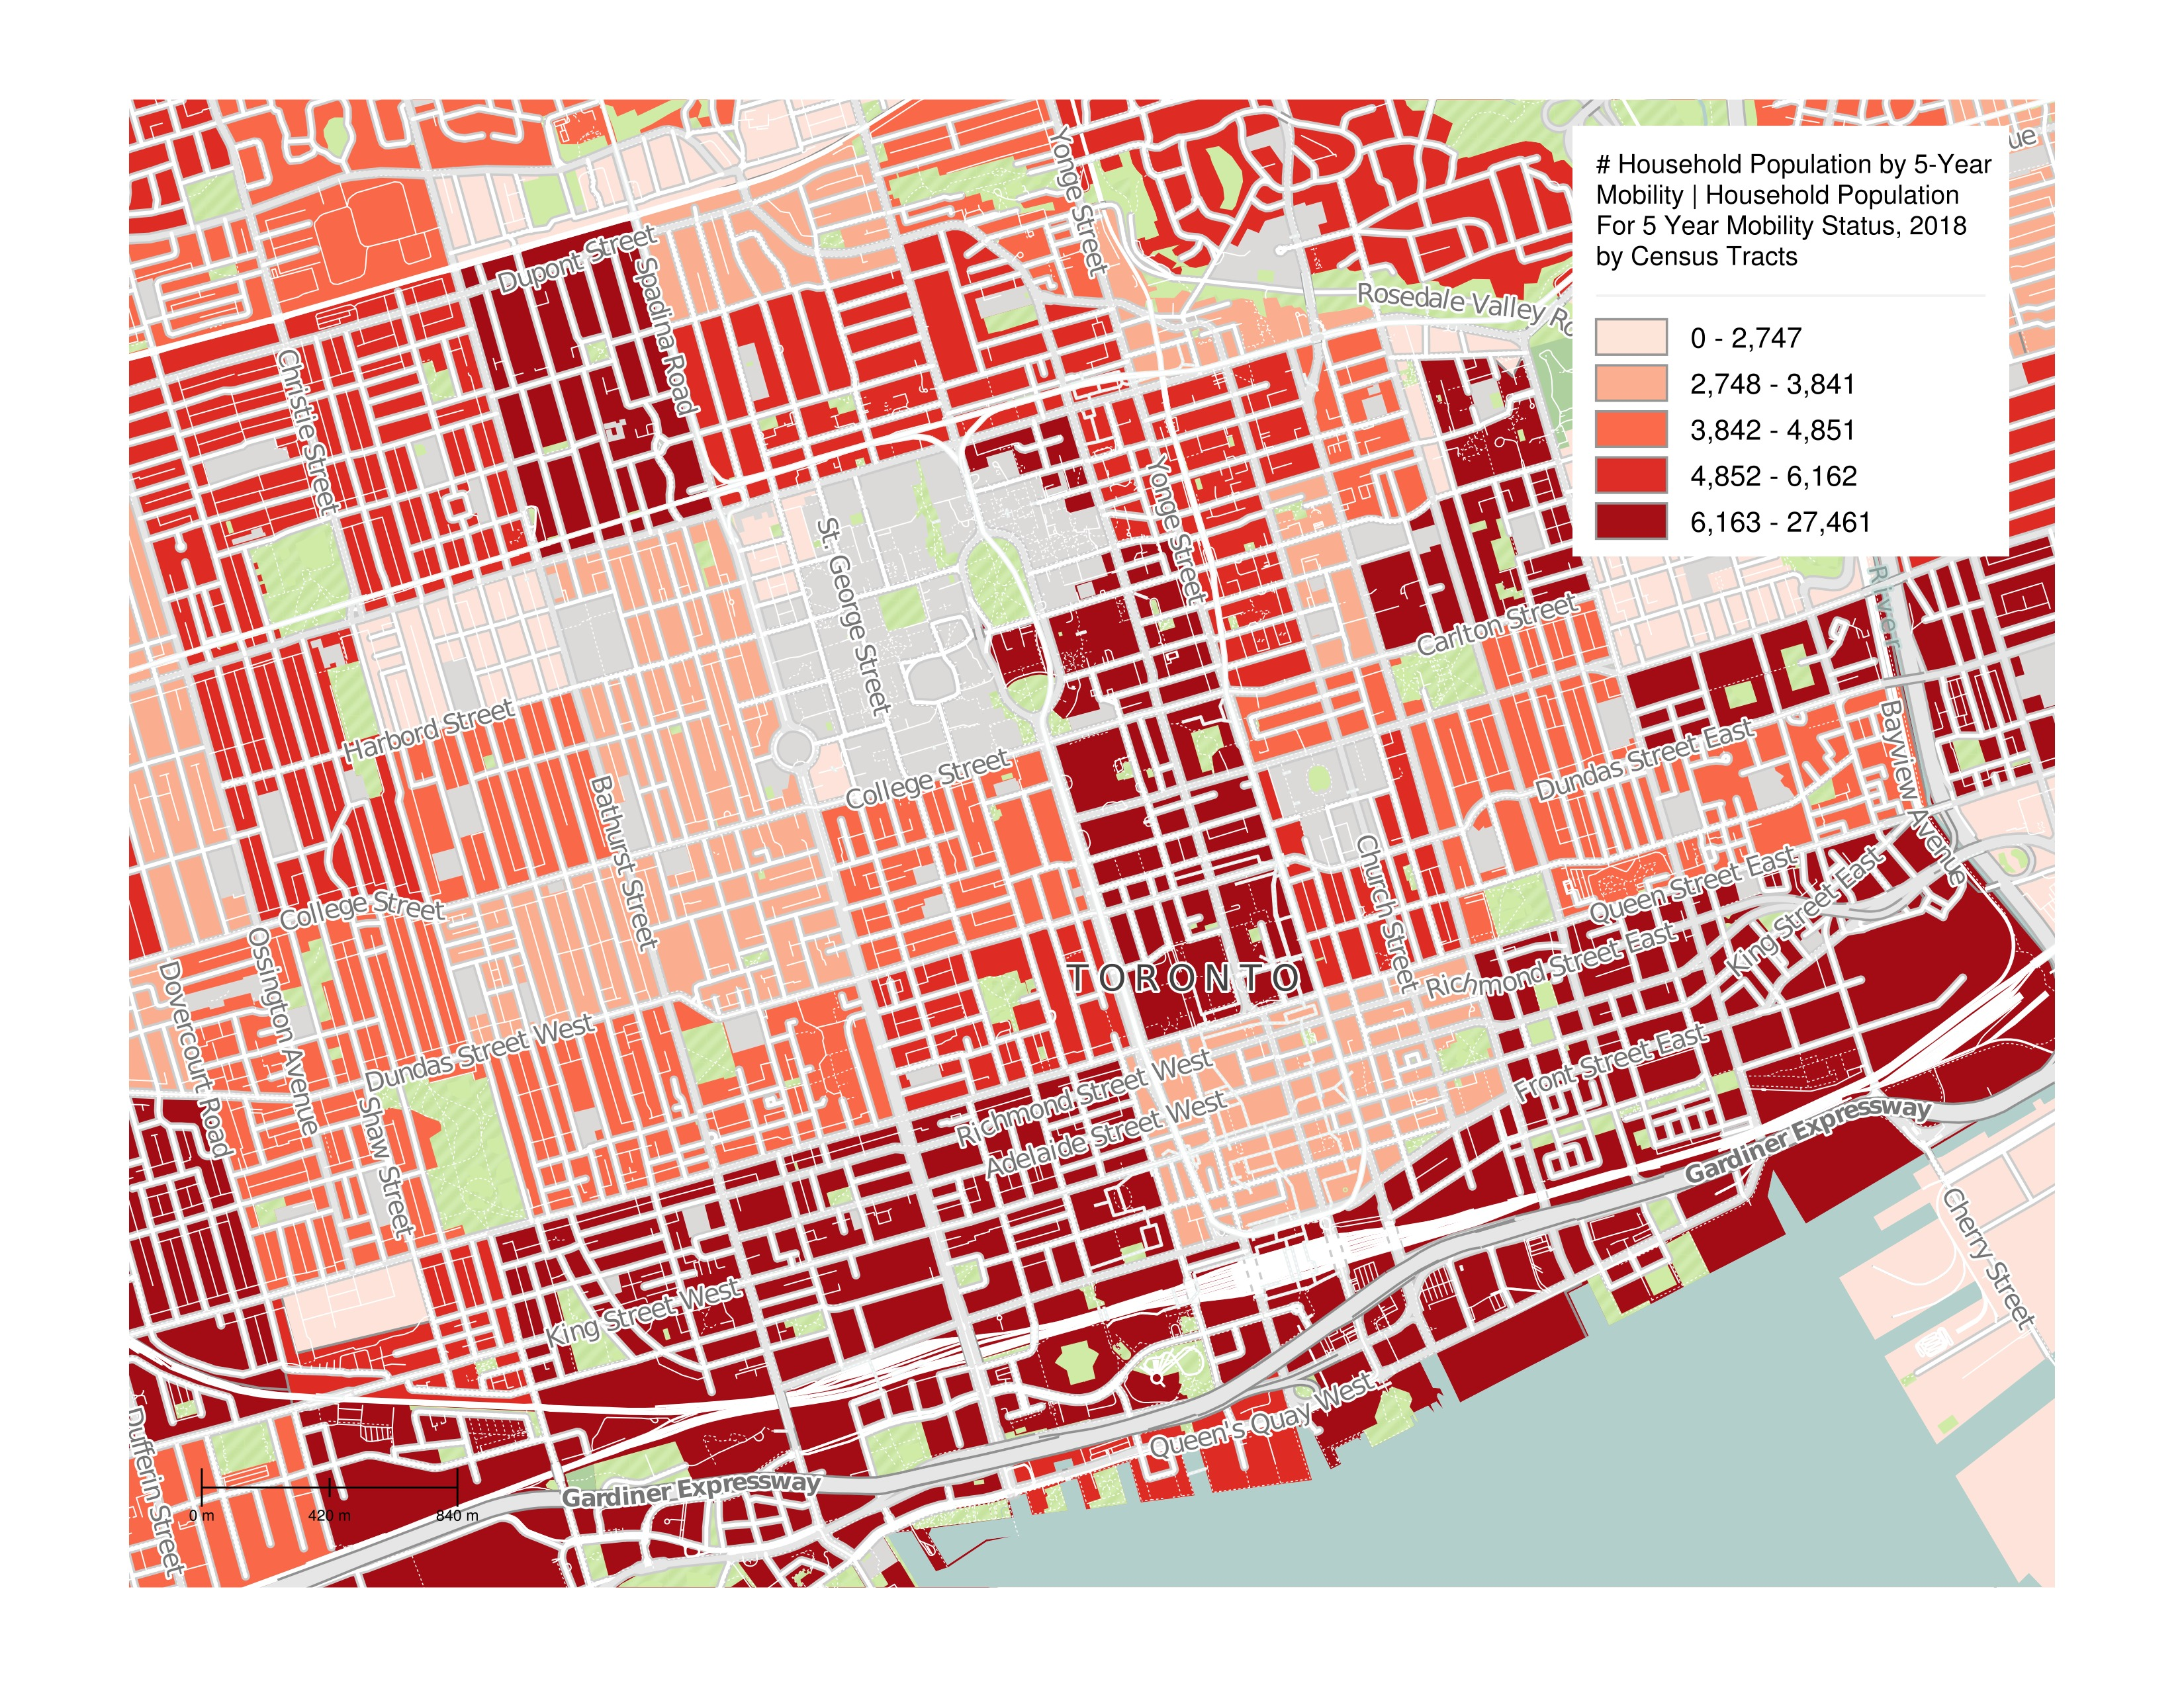

Slide 22
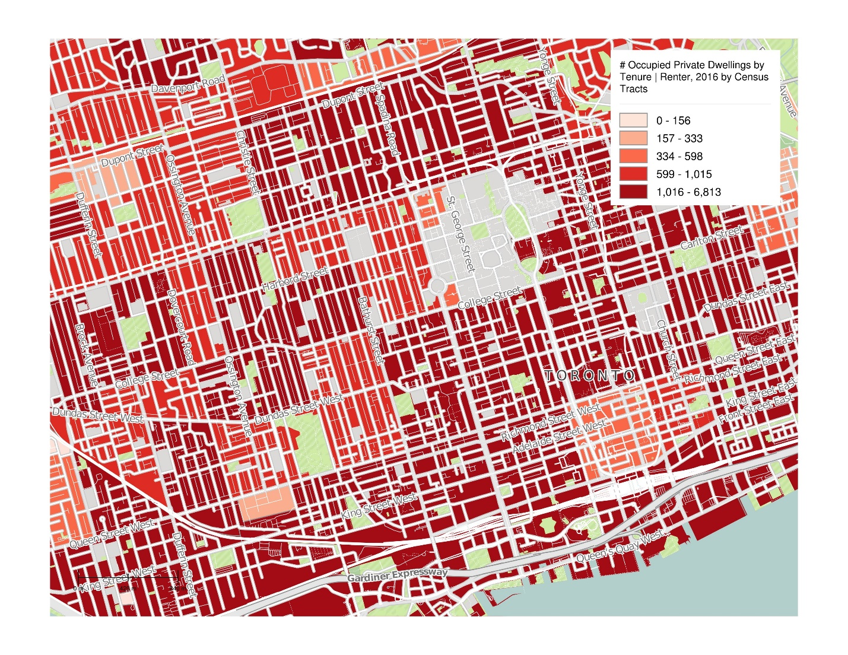

Slide 23
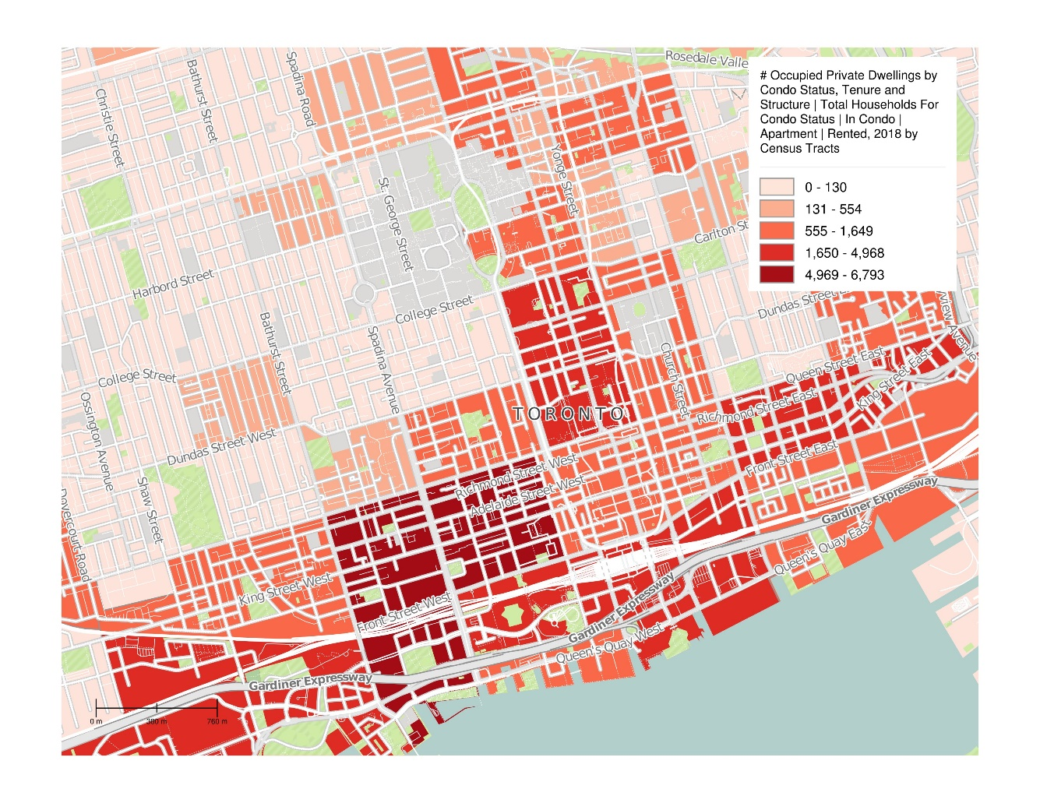

Slide 24
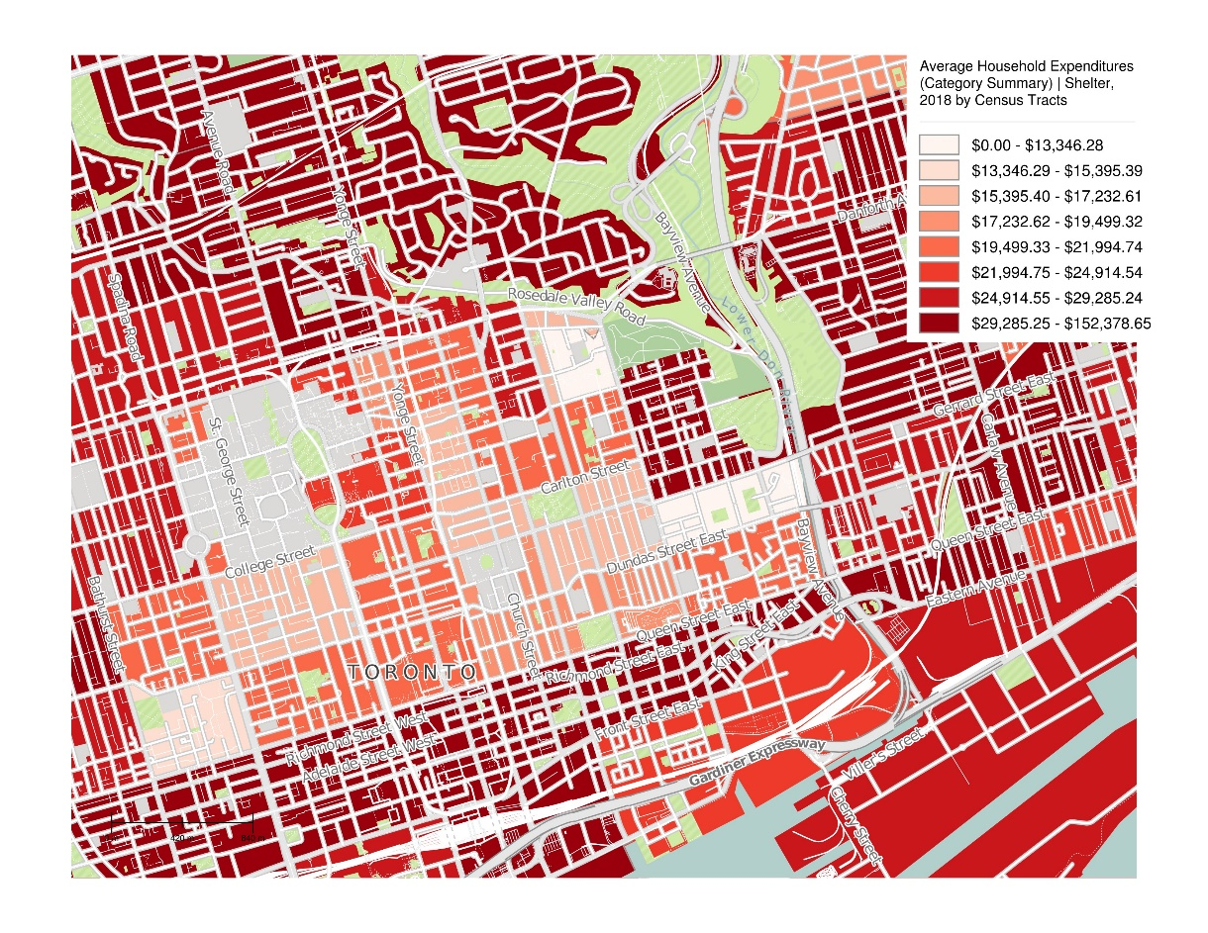

Slide 25
Questions
Thank you!

